Slide 1
$4.87M Override
Balancing Services, Costs, and Tax Capacity • Town of Berkley

Slide 2
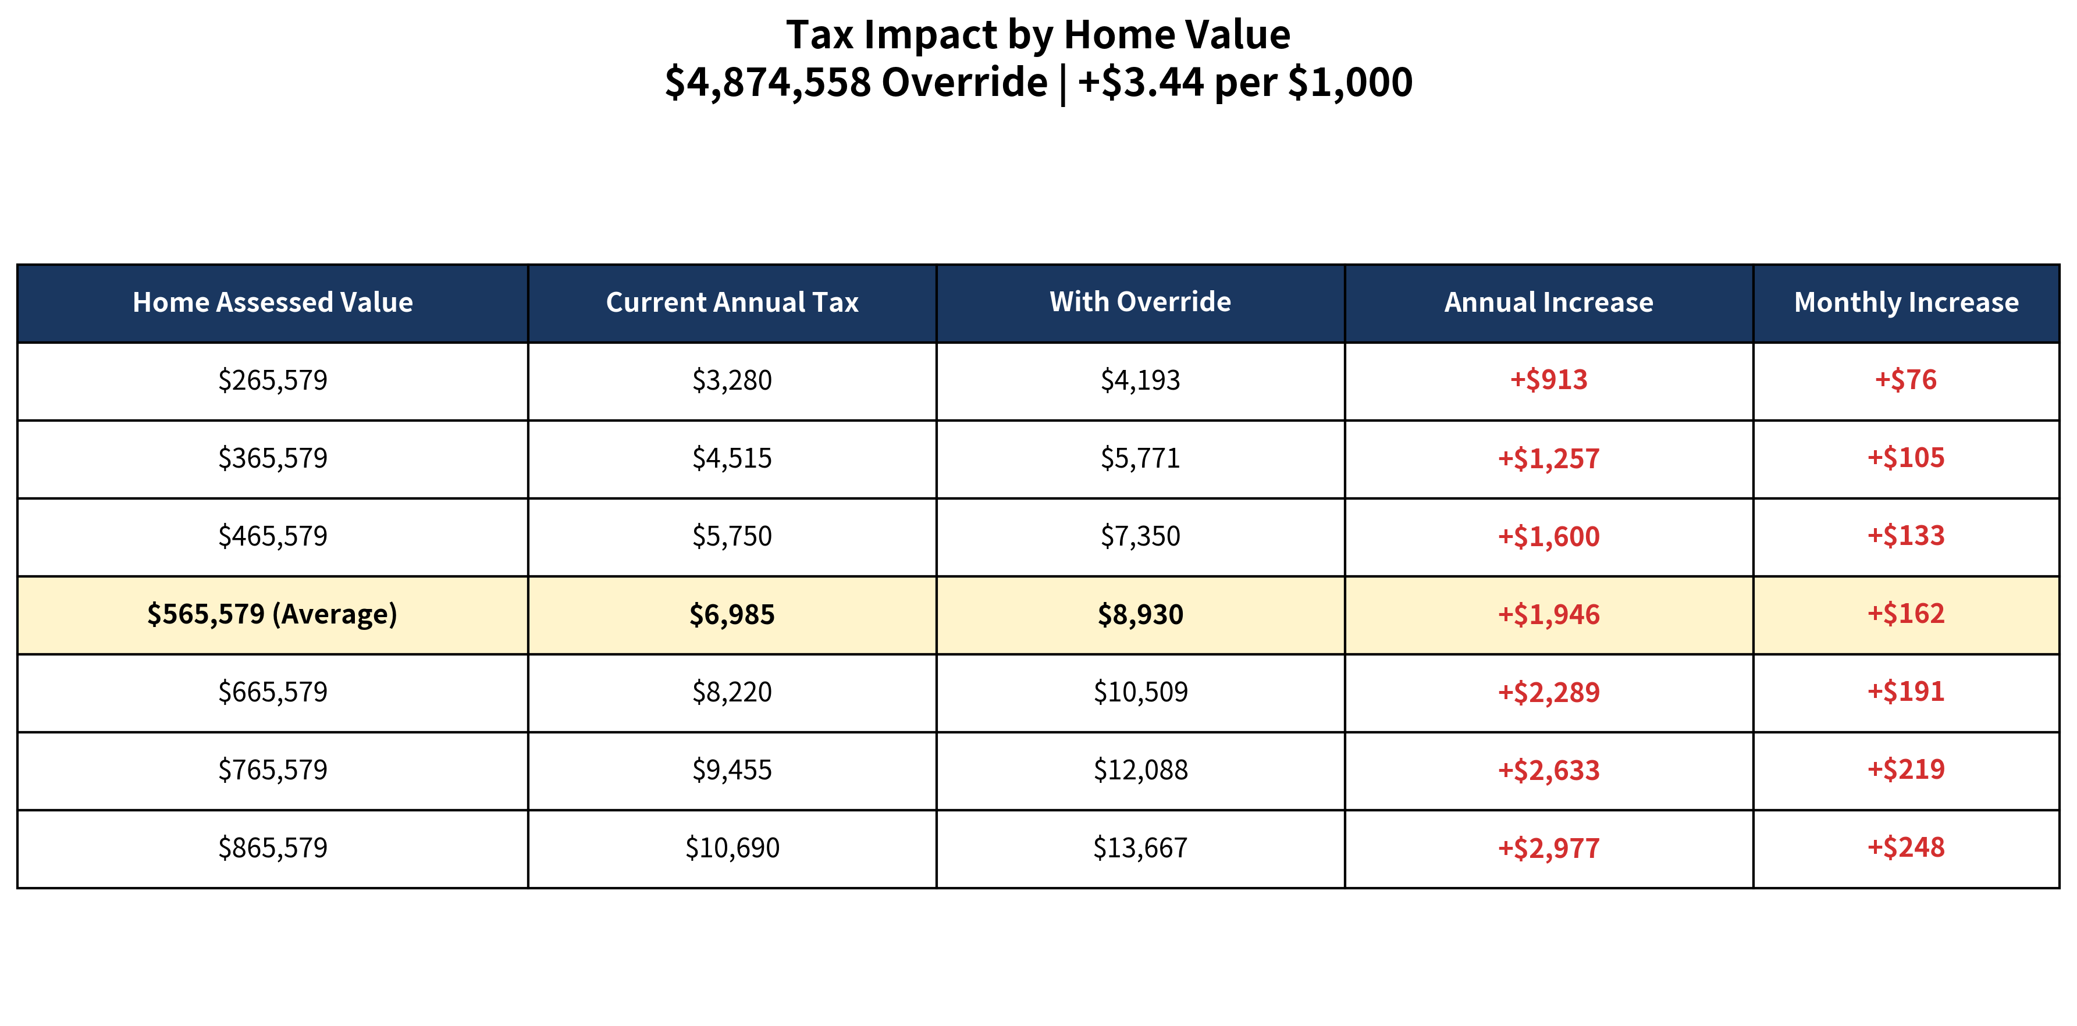
Tax Impact by Home Value

Slide 3
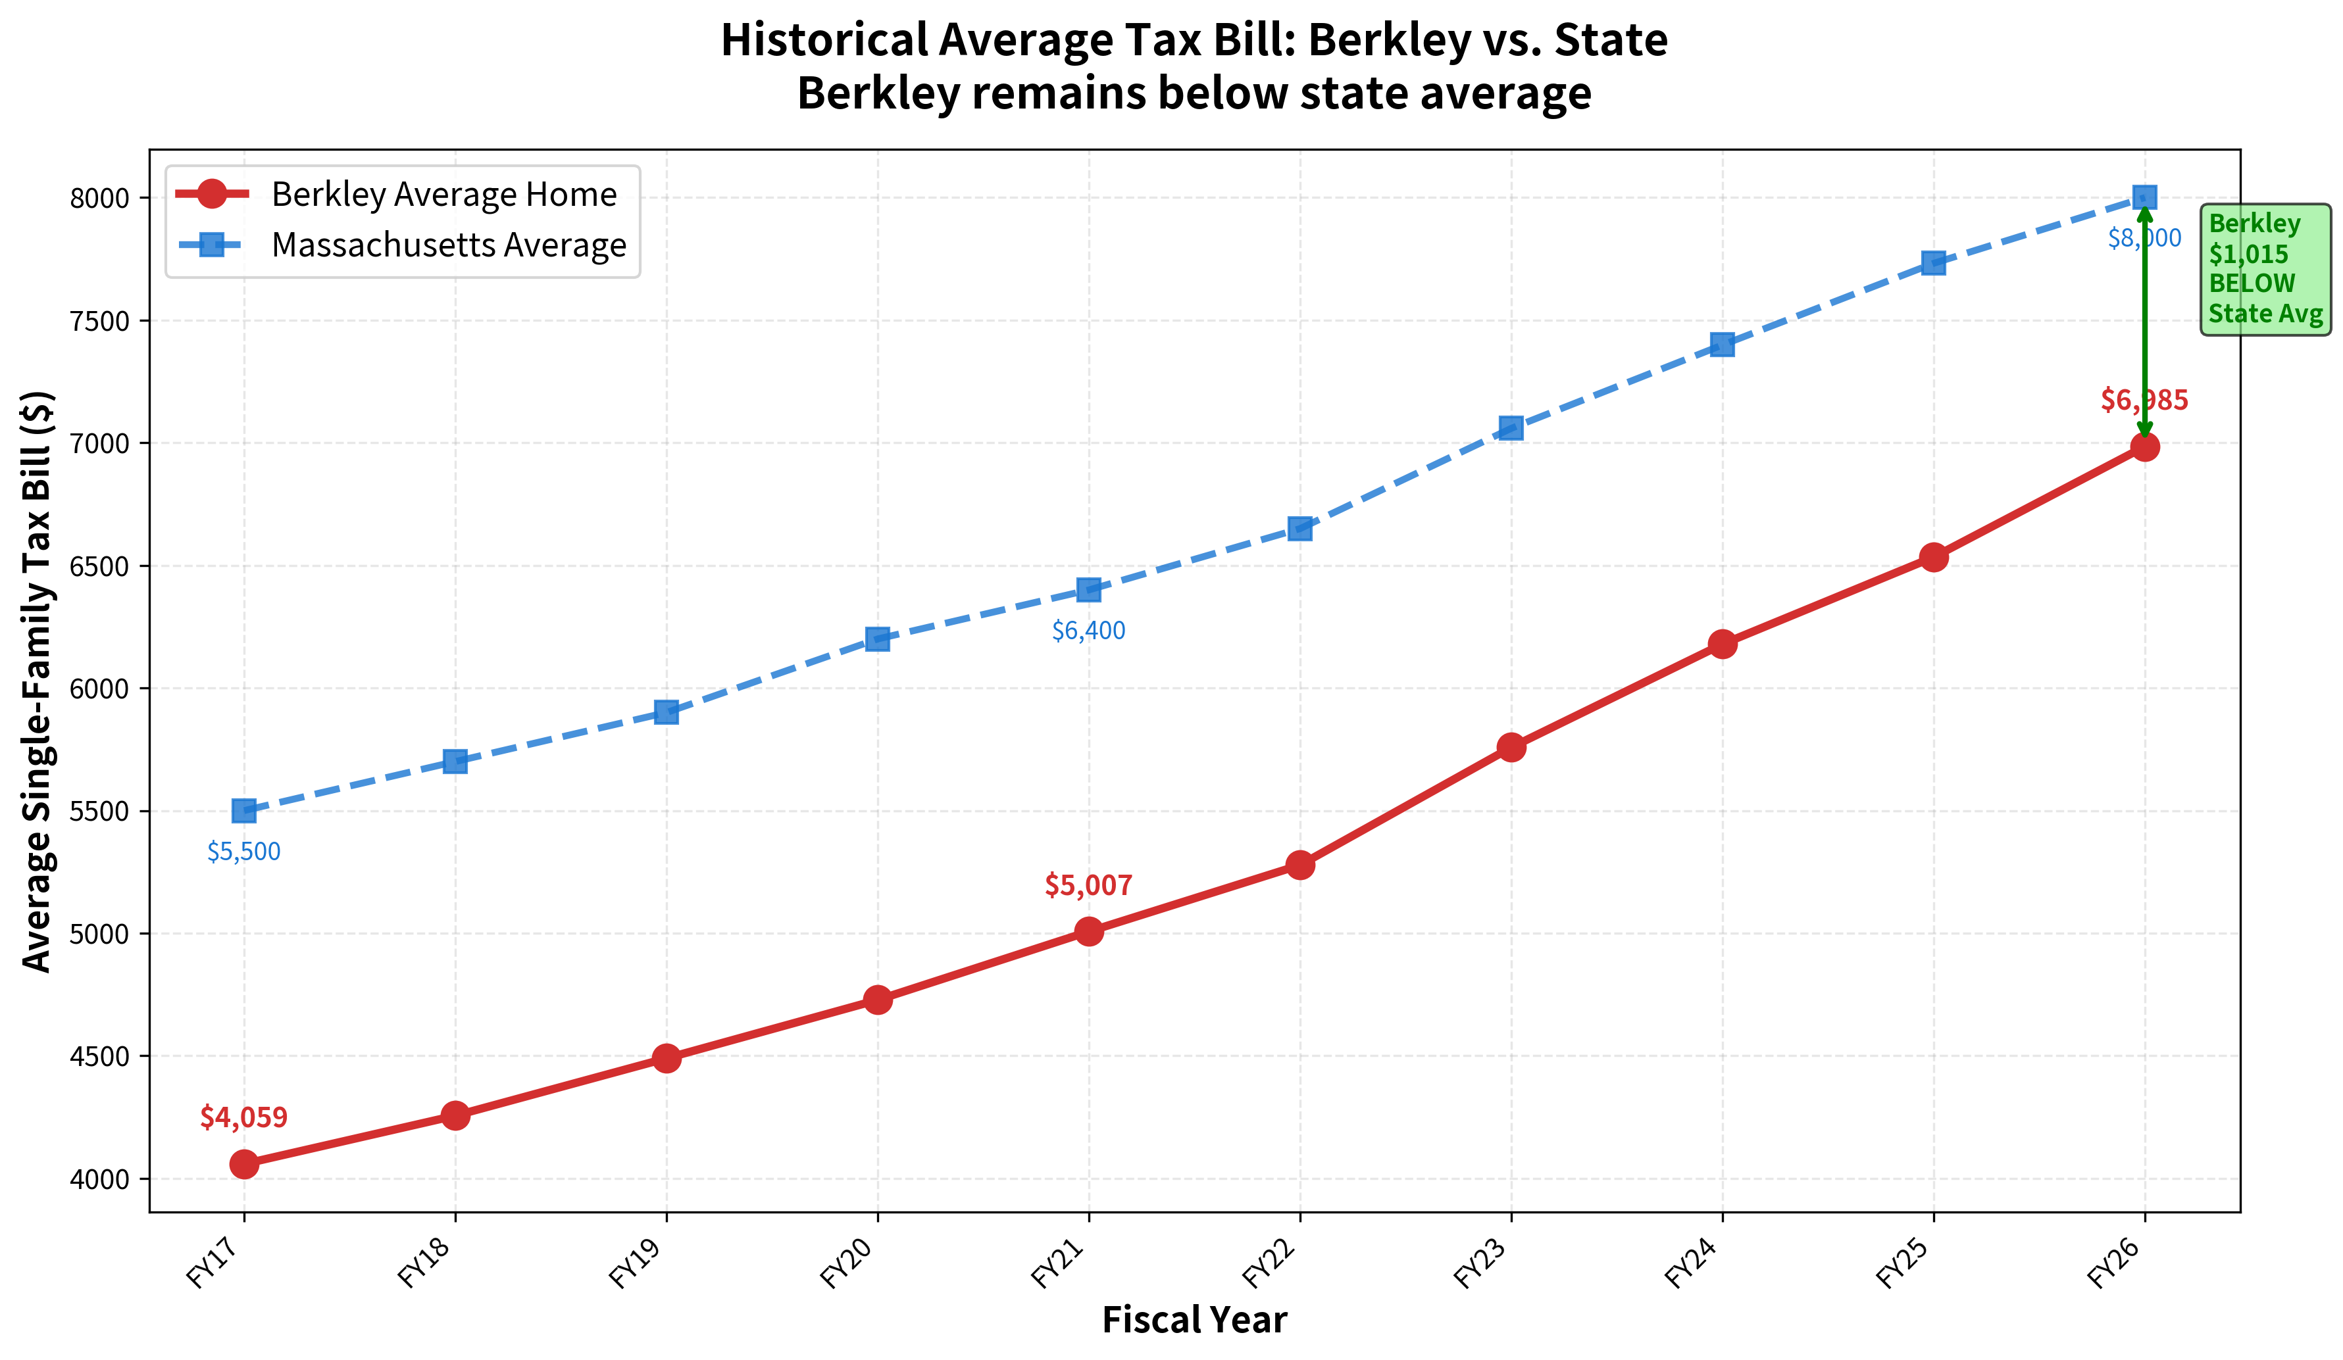
Historical Tax Bill Context

Slide 4
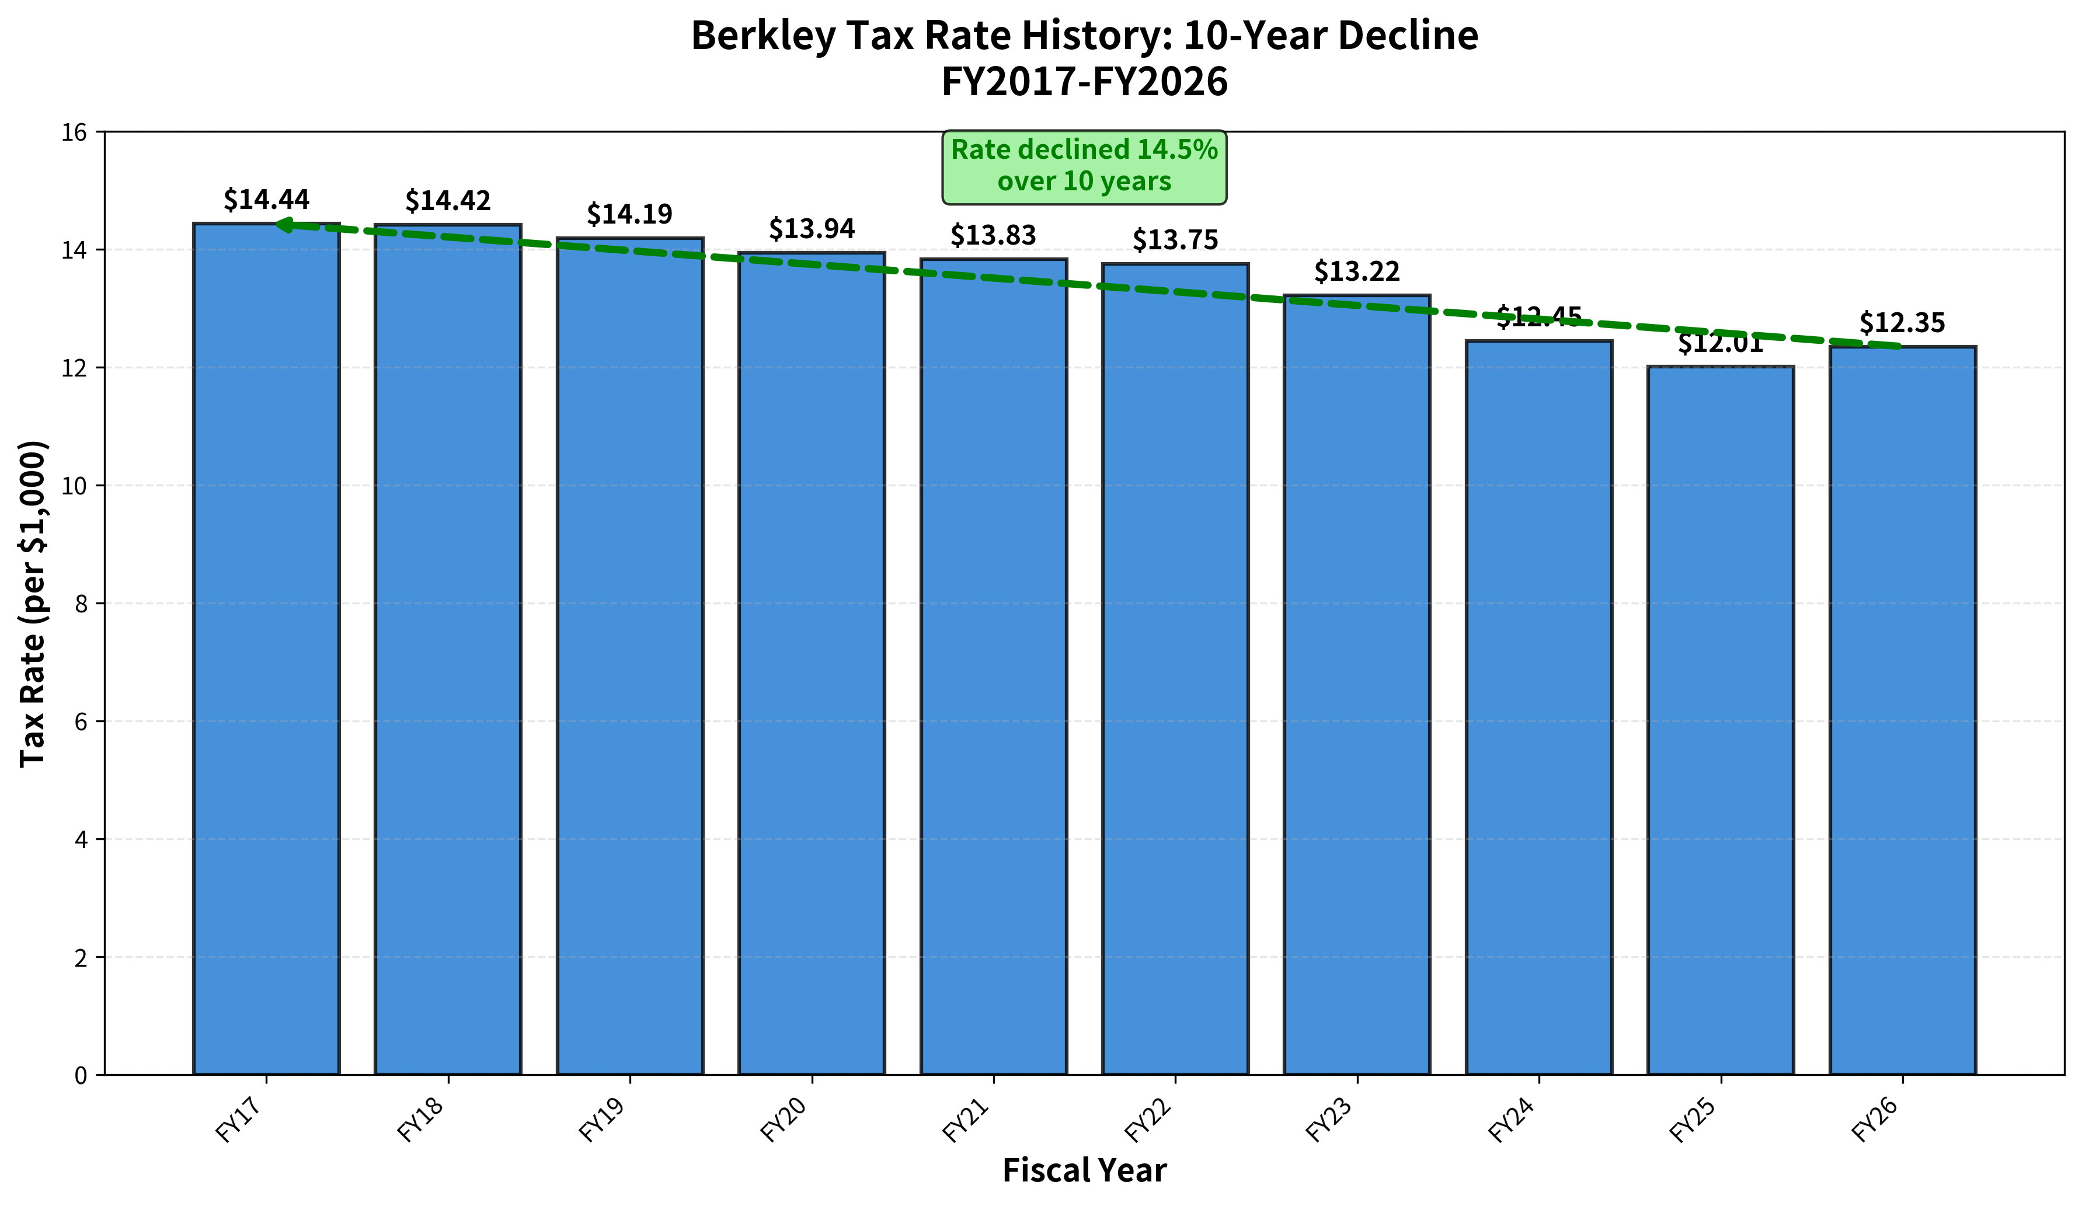
Tax Rate History: 10-Year Decline

Slide 5
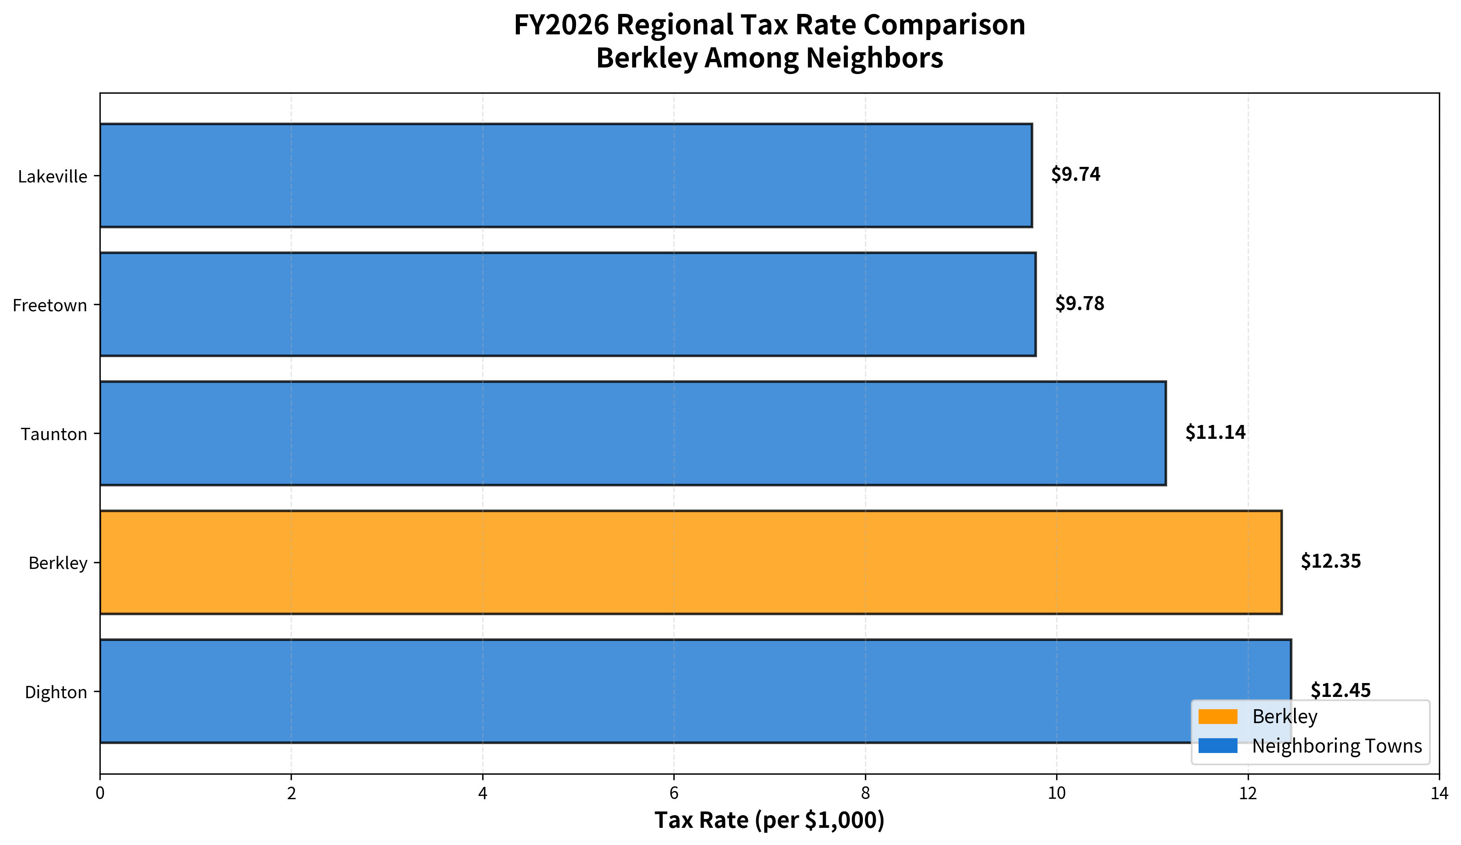
Regional Tax Rate Comparison

Slide 6
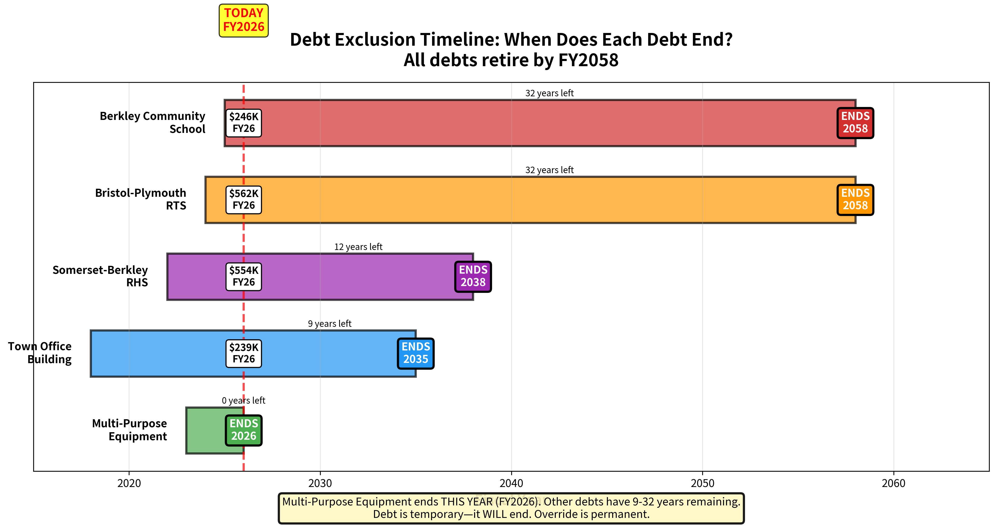
Debt Exclusion Timeline

Slide 7
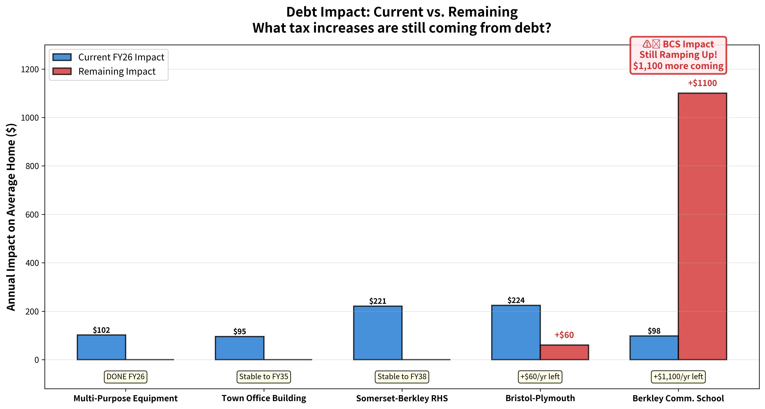
Remaining Debt Impact

Slide 8
Tax Impact Summary
Current Context: Berkley’s residential tax rate is generally comparable to regional peers and near the statewide average. The average single-family tax bill is higher than most immediate neighbors, but remains below the statewide average.
Projected Impact: An override of this magnitude, combined with upcoming excluded debt, would move Berkley above statewide averages for both the residential tax rate and the average single-family tax bill.

Slide 9
Berkley Override History
Fiscal Year | Vote Date | Win/Loss | Department | Amount
1991 | 12/1/1990 | FAIL | General | $230,611
2007 | 5/8/2004 | FAIL | General | $1,900,000
2007 | 11/5/2002 | FAIL | General | $750,000
2007 | 5/6/2006 | PASS | High School | $800,000
2011 | 6/26/2010 | PASS | General | $275,000
2011 | 6/26/2010 | PASS | High School | $500,000
2011 | 6/26/2010 | PASS | School | $500,000
2018 | 7/15/2017 | FAIL | High School | $950,000
2019 | 5/12/2018 | PASS | High School | $870,000

Slide 10
Berkley Override History
Over the past 35 years, Berkley has had nine Proposition 2½ override questions before voters
No override passed until FY2007, which is more accurately characterized as the first of three stabilization-fund overrides related to the Somerset Berkley Regional High School, completed in FY2019
According to Division of Local Services records, Berkley has approved one general operating override
Debt exclusions have historically been more successful:
17 debt exclusions attempted
16 approved by voters

Slide 11
Why That Number?
Restoring Capacity
not merely to maintain survival-level or “level service” operations
restore previously lost positions
rebuild a more resilient General Government structure
Long-Term Stability
structured to extend into the future, not address a single-year gap
provide predictable funding over multiple years
reduce the frequency of recurring override discussions

Slide 12
What “Restoring Capacity” Means
Restoring capacity refers to rebuilding staffing levels, operational support, and internal structure that allow the Town to function reliably and sustainably.
Two full-time Firefighter/Paramedics (bringing staffing to 9)
Two full-time Police Officers (bringing staffing to 11)
Restoration of previously eliminated positions within Berkley Public Schools
Increased funding for materials and operating expenses in the Highway Department to support core services and infrastructure upkeep

Slide 13
What “Restoring Capacity” Means
Extension of hours for critical Town Hall positions
Restoration of positions lost to vacancy in General Government
Additional detail and discussion:
SAVE Task Force public forums
Upcoming Finance Committee meetings
Budget Microsite

Slide 14
What “Long-Term Stability” Means
Time to Advocate: Provides the Town with sufficient runway to pursue legislative and administrative changes to address stagnant state aid.
Time to Adjust: Allows for measured, deliberate budget and service decisions rather than annual crisis management.
Time to Plan for Growth: Creates the fiscal space to evaluate and implement growth strategies, if desired by the community, rather than being forced by short-term constraints.
Time to Protect Services: Stabilizes core services while longer-term revenue and cost solutions are pursued.

Slide 15
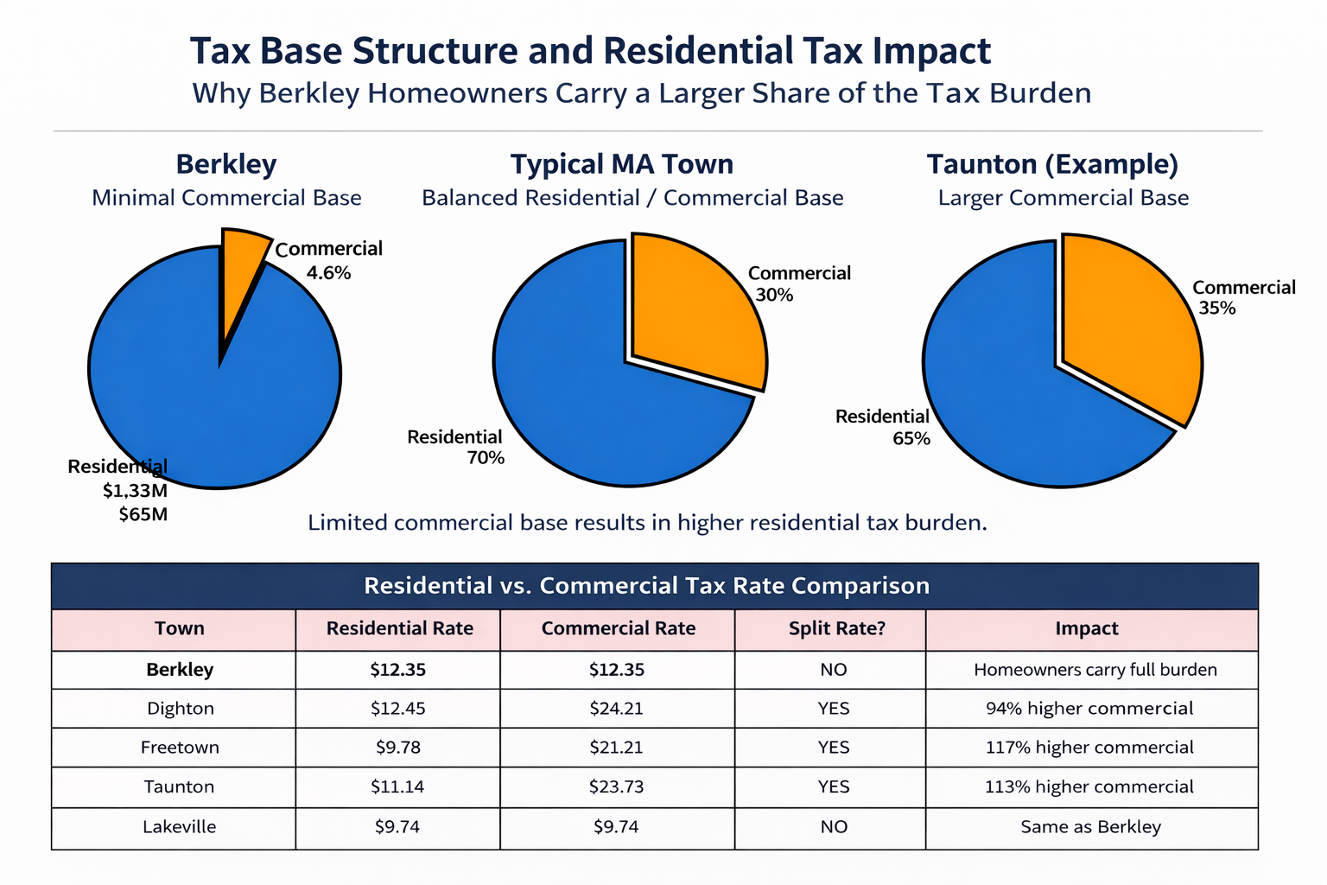
How: Tax Base & Split Rate Comparison

Slide 16
How: State Aid and Assessments

Slide 17
How: Inflation

Slide 18
How did we get here: Summary
Residential Tax Base
Berkley is among the top 10% of municipalities statewide in residential and open-space valuation as a share of total assessed value.
In practical terms, Berkley is dominated by single-family residential development, leaving homeowners responsible for nearly the entire local tax burden.
State Aid Trends
State aid growth has been modest and insufficient to keep pace with service costs.
Over the past five years, Unrestricted General Government Aid has increased by approximately $70,000, while Chapter 70 education aid has increased by approximately $300,000.
This level of growth is inadequate to sustain local services and has increased reliance on the property tax levy and local receipts.
Inflation and Cost Pressures
Inflation since calendar year 2020 has significantly outpaced historical norms.
While inflation has moderated, it remains above the pre-COVID baseline of sub-2%, and labor market dynamics have structurally changed.
Persistent 3%+ cost growth, combined with the 2.5% annual levy limit, continues to create structural pressure on the Town’s finances.

Slide 19
Addressing the Structural Deficit: Two Paths Forward
“The annual budget presented at town meeting should be balanced, meaning estimated expenditures are no greater than projected recurring revenues. Recurring revenue is total revenue less capital and debt exclusions and any other specific non-recurring revenue items (e.g., free cash, stabilization).” July 2025 FMR

Slide 20
Addressing the Structural Deficit: Two Paths Forward
Path One: Guidelines Budget
Balanced through reductions
Achieves a structurally balanced budget through ~6% cuts
Reductions applied across departments
Results in:
  Service level reductions
  Deferred capacity and responsiveness
  Focus on maintaining only core operations
Path Two: Needs Budget
Balanced through investment
Invests in departments to:
  Restore lost capacity
  Deliver demonstrable service improvements
Enhances:
  Public safety, operations, and administrative support
  Reliability, response times, and resilience
Requires new recurring revenue to achieve structural balance

Slide 21
Berkley Public Schools
Guidelines Budget
$8,629,200
General operations (excluding Collaboratives & Transportation)
Requires significant reductions
Estimated loss of 10+ staff positions
Programmatic and service-level impacts across the district (Class size increases)
Focuses on maintaining minimum operations within existing revenues
Outcome: Structural balance achieved through staffing and service reductions.
Needs Budget
$10,606,484
General operations
Restores 7 of 13 lost positions; Grade 1 teacher, BMS Art teacher and Special Education teacher
Does not restore ESSER-funded positions
Allows schools to operate at sustainable service levels
Direct year-one investment:
$1,977,284
Outcome: Structural balance achieved through investment in educational capacity.

Slide 22
Berkley Police Department/Communications
Guidelines Budget
$1,895,943
Maintains minimum operational coverage; two patrolman per shift
Limited flexibility for staffing, training, and supervision; no specialized officers on duty
Continued strain on patrol coverage and communications support;
Focused on baseline service delivery only
Needs-Based Budget
$2,301,519
Supports two additional patrolman (11)
Strengthens communications reliability and coverage
Improves response capacity
Addresses known operational pressures without expansion beyond core needs
Direct year-one investment:
$405,576

Slide 23
Berkley Fire/Rescue
Guidelines Budget
$1,061,476
Requires continued reliance on overtime and call staffing
Limited staffing flexibility for peak demand and simultaneous calls
Increased operational strain on existing personnel
Reduction of overnight call shifts
Needs-Based Budget
$1,495,042
Supports additional firefighter/paramedics (2)
Improves coverage, response reliability, and resilience
Reduces dependency on overtime as a structural solution
Enhances ability to respond to concurrent incidents and medical demand
Direct year-one investment:
$433,566

Slide 24
Berkley Highway Department
Guidelines Budget
$1,012,078
Elimination of part-time staffing for the transfer station
Elimination of two full-time staff - eight (8) reduced to six (6)
Transfer Station closed on Saturdays
Reduced flexibility for:
  Road maintenance
  Seasonal work
  Equipment support
Needs-Based Budget
$1,159,930
Retains part-time staffing capacity, retention
Maintains Saturday Transfer Station operations
Supports road materials purchases previously reduced
Improves reliability of core public works services
Direct year-one investment:
$147,852

Slide 25
Berkley Town Hall (General Government)
Guidelines Budget
$886,515
Reduced staffing (two part-time employees)
Limited ability to:
  Support boards and committees
  Maintain financial controls and internal systems
  Respond to resident service demands timely
Focused on compliance and transaction processing
Needs-Based Budget
$1,033,610
Restores staffing (supports two 32 hour positions)
Strengthens finance team, support staffing
Improves responsiveness to residents, boards, and departments
Direct year-one investment:
$147,095

Slide 26
Year-One Investment by Department

Slide 27
Long-Term Stability
From Investment to Stability
FY2027 Override Amount
$4,874,558
Less: Year-One Departmental Investment
($3,111,373)
FY2027 Surplus
$1,763,185
Deposited to Override Stabilization Fund

Slide 28
Long-Term Stability
How the Stabilization Fund Is Used
Supports continued departmental needs over a five-year horizon
Absorbs known cost pressures, including:
  Health insurance and pension increases
  Regional school district assessment growth
  Inflationary operating costs
Built using conservative assumptions for:
  Proposition 2½ levy growth
  Local receipts
  State aid increases

Slide 29
Questions & Discussion
Questions?

