Slide 1

Community Forum - How We Serve Berkley Everyday
Presented by:
Chief Jason Perry

Slide 2
Why We’re Here Tonight
To explain how Berkley Fire/Rescue operates day to day
To share current staffing, budget, and response realities
To explain how proposed FY27 budget reductions affect service
To answer questions and hear community concerns

Slide 3
Core Responsibilities of the Fire/Rescue Department
Emergency Response
Fire suppression and rescue operations
Emergency Medical Services (EMS) and Advanced Life Support (ALS)
Fire Prevention & Life Safety
Inspections of homes, businesses, and public buildings
Code enforcement and permitting (open burning, events, occupancies)
Public Education
Safety programs for residents, schools, and local businesses

Slide 4
Additional Responsibilities
Emergency Preparedness & Community Support
Emergency Management and CERT operations
Disaster and severe weather planning
Shelter and warming center operations
Community outreach and citizen assistance
Training, Readiness & Equipment
Ongoing Fire & EMS training multiple times each month
Maintenance of apparatus, tools, PPE, and medical equipment

Slide 5
Stations & Apparatus
Stations
Station #1 - Public Safety Building
Station #2 – 6 Grove Street (Unmanned)
Apparatus
3 Engines
2 Tankers
1 Ladder Truck
2 Forestry Trucks
2 Ambulances
2 UTV’s (1 Rescue & 1 Forestry)
2 Command Vehicles
1 Emergency Management Vehicle (Repurposed Ambulance)
2 Boats (Shared with Police)

Slide 6
Department Staffing
Full-Time Leadership & Support
Fire Chief
Deputy Chief
Administrative Assistant
Full-Time Operations Personnel
4 Firefighter/Paramedics
2 Firefighter/EMTs
Provide 24/7 in-station coverage and emergency response
On-Call (Call) Personnel
30 Firefighters, Firefighter/EMTs, and Firefighter/Paramedics
Supplement daily staffing and respond from home/work
Staff additional apparatus during major incidents
EMA / CERT
14 trained community volunteers

Slide 7
Daily Staffing Reality
Chief – Weekdays
Deputy Chief – Weekdays (Currently on rotation)
Administrative Assistant – 30 hours Mon-Thur
Minimum 2 personnel per shift (1 FF/Medic & 1 FF/EMT)
4 Group Rotations
2 Groups staffed with full-time staff
2 groups staffed with full-time & on-call staff combined
Off duty full-time and On-call Members toned in for callback on any call more than routine medical or still alarm

Slide 8
What a Normal Week Looks Like
Call Volume Reality
Over 1,000 calls per year, primarily EMS-related
Regularly occurring simultaneous incidents
Wide variety of responses, including:
  Medical emergencies
  Motor vehicle accidents
  Fire and CO alarm investigations
  Service calls and public assists
What Happens Between Calls
Apparatus and equipment checks
Restocking medical supplies
Reports and required documentation
Inspections, pre-plans, and prevention work

Slide 9
2025 Call Volume
We Responded To 1,086 Total Calls
549 EMS Calls
196 Motor Vehicle Accidents
145 Fire / CO Alarm Activations
68 Good Intent Calls
67 Service Calls
31 Hazardous Conditions
29 Fires
What This Really Means Operationally
207 incidents happened at the same time as another call
We gave mutual aid 45 times
We received mutual aid 22 times

Slide 10
Fire / EMS Budget Overview
Total Combined Budget: $1,140,920
$450,000 funded through ambulance billing revenue
$690,920 funded through local taxation
Personnel Costs
Full-time salaries (including Chief): $637,897
Call Firefighter/EMS wages: $198,000
Budget Reality
Less than 2% dedicated to capital purchases
Remaining funds support:
  Equipment maintenance and testing
  Medical supplies
  Fuel, utilities, and training

Slide 11

What This Means for Residents
Nearly 40% of the operating budget is offset by EMS revenue
$835,897 of the budget directly supports staffing availability
Very little funding flexibility exists outside of personnel costs
When EMS revenue fluctuates, the tax-supported portion must absorb the difference to maintain service levels

Slide 12
Staffing Challenges
Recruitment & Retention Challenges
Among the lowest pay rates in the region
Full-time Firefighter/Paramedic starting salary: $58,000
Call rates:
  Firefighter: $17/hr
  Firefighter/Paramedic: $23/hr
No compensation for training time for call personnel
Operational Impact
Difficulty attracting and retaining qualified providers
Training requirements deter new call personnel
Full-time staff leave for higher-paying departments
Increased strain on a small core group of responders

Slide 13
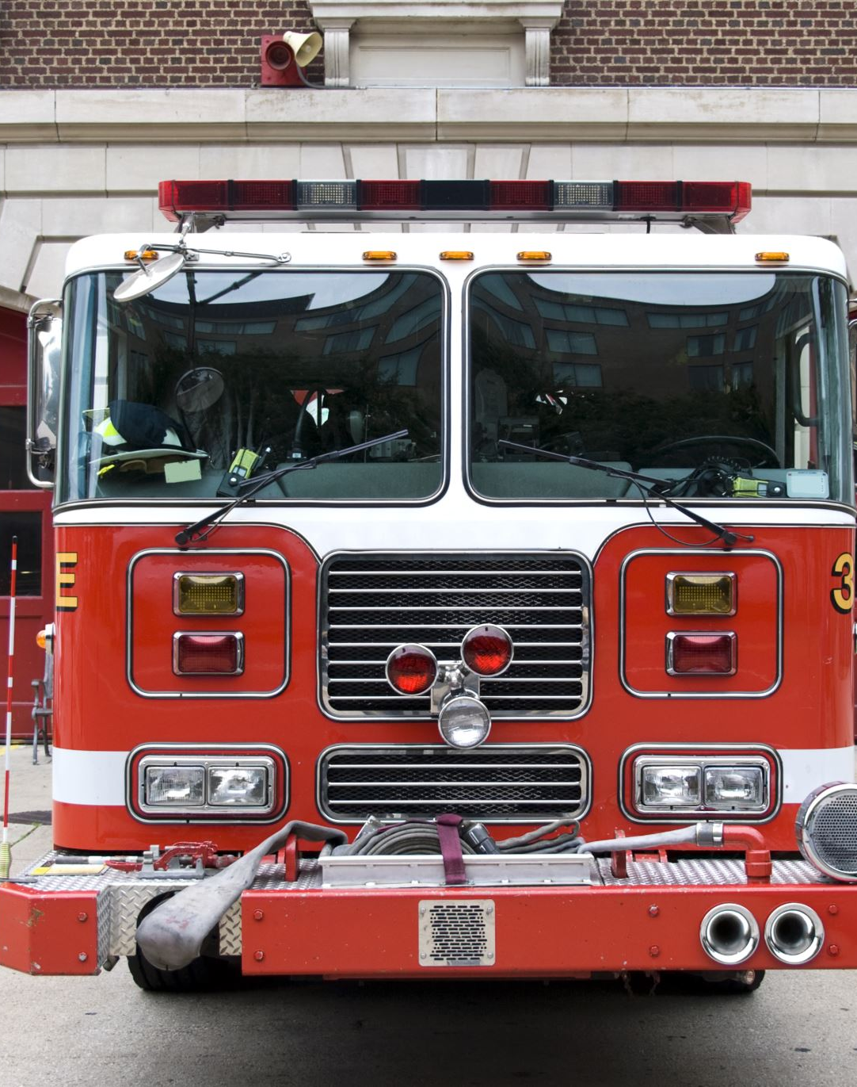
Adequate Staffing – What Standards Require
Ambulance Staffing (State Regulations)
Minimum staffing:
  1 Paramedic
  1 EMT
High-acuity calls require additional personnel
Fire Response Standards (NFPA Benchmarks)
4 firefighters per apparatus
First-due engine within 4 minutes
16 firefighters on scene within 8 minutes for a working structure fire

Slide 14
Adequate Staffing – The Reality in Berkley
On-Duty Staffing
2 firefighters on duty at all times
Cross-staffing ambulance and fire apparatus
How Additional Staffing Is Obtained
Call firefighters responding from home
Off-duty full-time personnel
Mutual aid partners
Key Limitation
Availability depends on time of day and day of week
Many call members work full-time jobs outside of town

Slide 15
2012 Staffing Study – Then vs. Now
2012 Study Findings
Recommended staffing:
  9 full-time personnel
  2 per shift
  Daytime Deputy Chief
Projected Growth Recommendation
By 2020:
  13 full-time personnel
  3 per shift
  Daytime Deputy Chief
Reality in 2025
7 full-time personnel total
Only recently reached 2 per shift in January 2024 using call staffing

Slide 16
Reliance on Call & Volunteer Staffing — A Growing Challenge
National Trend
Call and volunteer staffing models are declining across the country
Fewer people are able to live close enough to respond quickly and consistently
Berkley’s Reality
More than 70% of current full-time and on-call members do not live in Berkley
Contributing Factors
High cost of new homes
Lack of housing inventory and rental options
Low pay compared to surrounding departments
Significant initial training requirements for new call/volunteer firefighters

Slide 17
Cost Saving Measures We Use Daily
How We Stretch the Budget
Actively pursue state and federal grants to fund equipment and PPE needs
Utilize State Bid purchasing programs
Perform vehicle and equipment repairs in-house whenever possible
Revised dispatch protocols so less serious initial calls are handled by on-duty personnel only
Why This Matters
Reduces reliance on already limited operating funds
Keeps apparatus and equipment in service longer
Limits unnecessary call-backs to preserve staffing for higher-priority incidents

Slide 18
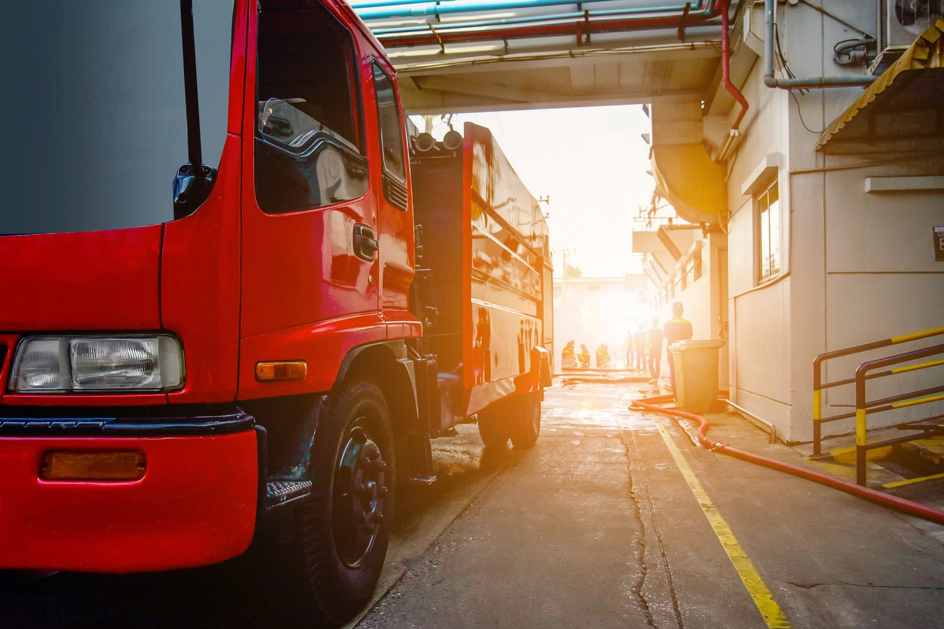
Fixed Costs Beyond Our Control
Required Annual Testing & Maintenance
Medical equipment inspection and maintenance
SCBA testing and certification
Fire hose, ladder and pump testing
Ongoing Operational Costs
Software and reporting systems
Utilities: electric, phone, internet, heat

Slide 19
Equipment Life Cycles & Replacement Planning
Typical Replacement Timelines
Fire apparatus: 15–20 years
Ambulances: 8–10 years
PPE: 10 years
Radios, SCBA, medical equipment: 10–12 years
Why This Matters
Driven by NFPA standards and manufacturer recommendations
Delaying replacement increases failure risk and costs
Planning must occur years in advance

Slide 20
Rising Costs & Long Lead Times for Critical Equipment
What We’re Seeing in the Market
Fire apparatus costs up ~100% in 5 years
  Build time: 2–3 years
Ambulance costs up 50%+
  Build time: 2+ years
Equipment and PPE costs up 50%+
Why This Matters
Replacement cycles must be planned years in advance
Annual price increases make long-term budgeting unpredictable
Delays and price increases make emergency replacements extremely difficult
Extending the life of current equipment is necessary but not a permanent solution

Slide 21

Areas of Immediate Concern
Aging Apparatus
1983 Tanker and 1988 Engine remain in service
Replacement previously identified but unfunded
Mandated PPE Replacement
PFAS-free PPE required by January 1, 2027
Estimated cost: $250,000+
No funding source identified
Ambulance Funding
Increased use of EMS revenue for operations
Insufficient funds for next ambulance in ~2 years

Slide 22
FY27 Guidelines Budget – What It Means
Budget Impact
6% reduction from FY26
Overnight Staffing (8 PM – 8 AM)
Loss of call personnel used for in-station coverage
Reduced to 1 Firefighter/Paramedic in station
EMS Impact
Second EMS provider responds from home
Increased on-scene times
Fire Impact
On-duty member must wait for additional personnel
Delayed apparatus response overnight

Slide 23
Additional FY27 Budget Impacts
Staffing & Readiness
Loss of funding to hire new on-call firefighters
Reduced ability to maintain adequate call staffing levels
Safety Equipment
Loss of funding to purchase PPE for new and existing firefighters
Emergency Management
Reduction in Emergency Management funding

Slide 24
Why These Changes Are Occurring
These impacts are not operational choices
01
They are the direct result of the FY27 Guidelines Budget reductions
02
Staffing and resource limits create unavoidable service constraints
03

Slide 25
Our Commitment to Berkley
Professional, dedicated response on every call
Responsible use of available resources
Transparency with the community
Collaboration with town leadership
Continued focus on public safety and fiscal responsibility

Slide 26

Questions & Discussion

