Slide 1
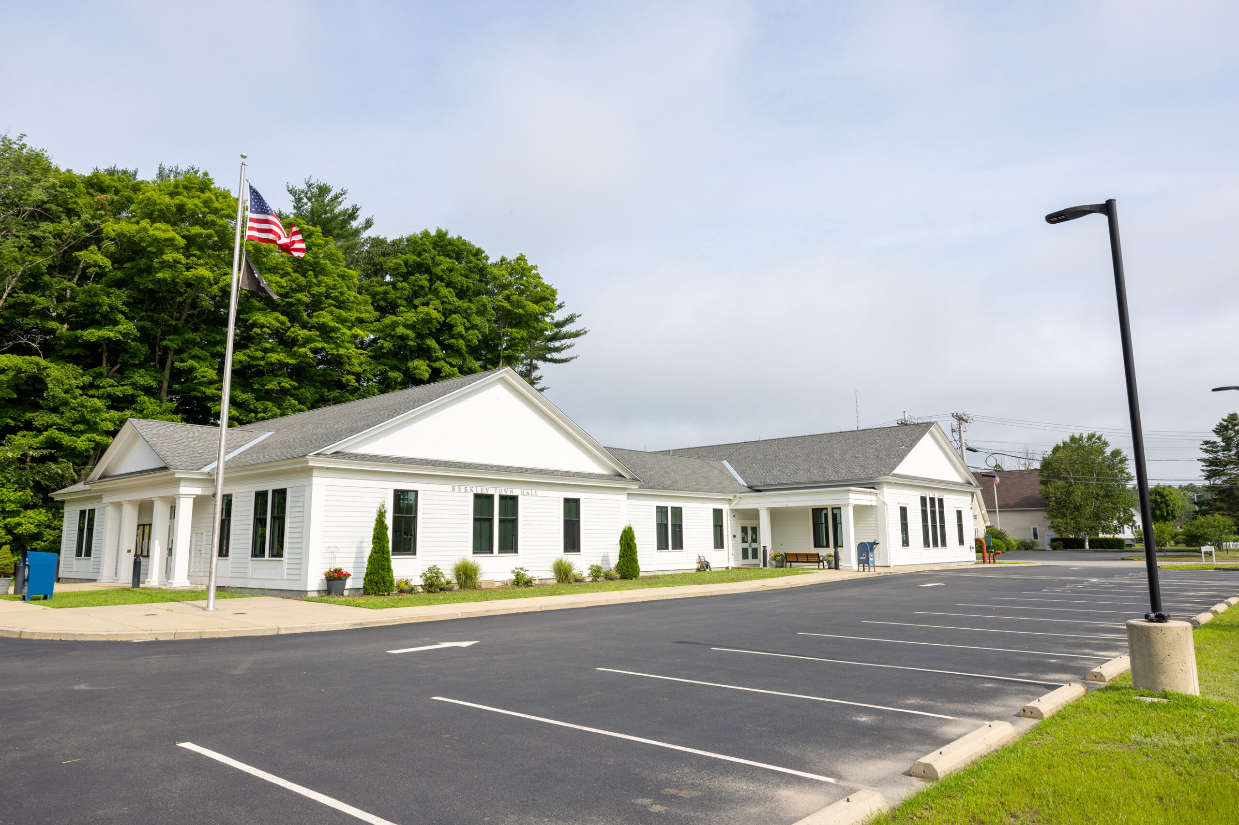

Fiscal Year 2027 Revenue Projections
Financial Advisory Committee
January 28th, 2026

Slide 2
FY 2027 Revenues by source
$ 28,970,356

Slide 3
FY 2027 Projected Revenues
Totals
Tax Levy and Exclusions | $20,091,714
State Aid | $6,564,409
Local Receipts | $1,829,233
EMS Reserved | $485,000
Total | $28,970,356
*All figures are estimates: State Aid figures represent Governor’s Local Aid Proposal, Local Receipts represent conservative budgeted increases, EMS Reserved Receipts represent no increase year-over-year.

Slide 4
Year over Year Revenue
 | FY2026 | Revenue Growth | FY2027
General Levy | $12,631,915 | + $475,798 | $13,107,713
Debt Exclusions | $1,856,510 | + $2,014,336 | $3,870,846
SBRHS Appropriation | $3,013,899 | + $99,256 | $3,113,155*
State Aid | $6,089,964 | + $474,445 | $6,564,409
Local Receipts | $1,594,614 | + $234,619 | $1,829,233
EMS Receipts | $485,000 | $0 | $485,000
Totals | $25,984,294 | + $2,986,061 | $28,970,356
*Contingent on assessment, this figure represents the maximum which can be raised in FY2026

Slide 5
Property Tax Levy
What is the property tax levy?
Largest source of local government revenue
Raised from real and personal property taxation
Includes levy, 2.5% increase, new growth, Regional School District overrides and debt exclusions
Single Family Averages (FY2026)
 | Berkley | Statewide*
Tax Bill | $6,985 | $8,114
Residential Value | $565,579 | $743,136
*Based on 345 of 351 communities reporting

Slide 6
FY 2027 General Tax Levy
Previous Fiscal Year’s Levy multiplied by (2.5%)
Includes new growth estimates to create the new General Levy
Raised from real and personal property taxes
FY2026 General Levy | $ 12,631,915
Prop 2.5 Increase | $ 315,798
New Growth (estimated) | $ 160,000
FY2027 General Levy | $ 13,107,713

Slide 7
New Growth
New growth is projected based on the anticipated construction new single- family homes, new commercial developments, personal property assessments, and historical averages.
Future development may help drive new growth and increase its importance as a consistent source of revenue growth.
New Growth History & Projection
FY2027 Estimated | $160,000
FY2026 Certified | $189,444
FY2026 Estimated | $160,000
FY2025 Certified | $159,614
FY2025 Estimated | $160,000

Slide 8
New Growth

Slide 9
FY 2027 Exclusions
Four items eligible for excluded debt:
Town Office Building | $ 239,250
Somerset Berkley High School* | $ 554,112
Bristol Plymouth High School* | $ 638,170
Berkley Community School | $ 2,439,314
Total Excluded Debt | $ 3,870,846
*Capital Assessments not finalized; based on fluctuating enrollment
Exclusions are so called because they are excluded from the levy and are not subject to Prop 2.5 increases; taxes are raised to pay the debt. Once retired, tax increases attributed to these items stop.

Slide 10
Regional School district Stabilization
The Town of Berkley approved three overrides over the past twenty years to support its growing enrollment at the Somerset Berkley Regional School District.
Funds raised from taxation are transferred into the special purpose stabilization and appropriated from this stabilization fund to pay the Town’s annual assessment.
These funds are subject to a 2.5% tax increase each year.
In FY2026, Special Purpose Stabilization was also used to supplement Out-of-District Special Education costs.
FY 2026 (Appropriation into RSD Stabilization) | $3,037,225
FY 2026 Assessment | $3,013,899
Balance increase | $ 23,356

Slide 11
State Aid and Assessments
The two largest forms of state aid are Chapter 70 and Unrestricted General Aid.
FY27 State Aid estimates are based on FY27 Governor’s Local Aid Proposal
FY27 State Aid Estimate: $6,555,504 Net increase of $334,771 over FY26 Budgeted.
Chapter 70 increase of 1.04% to $4,363,773; current $75 increase per pupil.
Unrestricted State Aid increase of 1.39% to $776,326.
Assessments – Cherry Sheet Assessments are those paid to the Commonwealth and Bristol County.
Payments to the MBTA, Regional Transit Authority, County Tax , and School Choice Sending

Slide 12
State Aid and Assessments

Slide 13
Local Receipts
Examples of Local Receipts include:
Motor Vehicle Excise constitutes 60% of total
Transfer Station receipts
Solar Field rental
Marijuana excise
Meals Tax
Licenses and Permits
Local Receipt Totals
FY2027 Budgeted (Proposed) | $ 1,829,232
FY2026 Budgeted | $ 1,594,614
FY2025 Actual | $ 2,336,778
*Conservative estimates to reflect volatility in local receipts.

Slide 14
Historical Local Receipts

Slide 15
Local Receipts – FY27 Proposed Increases
Class | FY2026 Budgeted | FY Budgeted | Proposed Increase
Motor Vehicle Excise | $ 920,000 | $ 1,030,039 | $ 110,039
Other Excise | $ 19,000 | $ 27,904 | $ 8,904
Rentals Solar | $ 162,149 | $ 163,854 | $ 1,705
Meals Tax | $ 40,000 | $ 42,000 | $ 2,000
Pen. & Int. | $ 90,000 | $ 90,000 | $ -
Other Charges | $ 100,000 | $ 116,505 | $ 16,505
Fees | $ 25,000 | $ 25,000 | $ -
License & Permits | $ 127,500 | $ 132,430 | $ 4,930
Fines | $ 10,965 | $ 20,000 | $ 9,035
Invest Income | $ 100,000 | $ 181,501 | $ 81,501
Totals | $1,594,614 | $ 1,829,233 | $ 234,619

