Slide 1
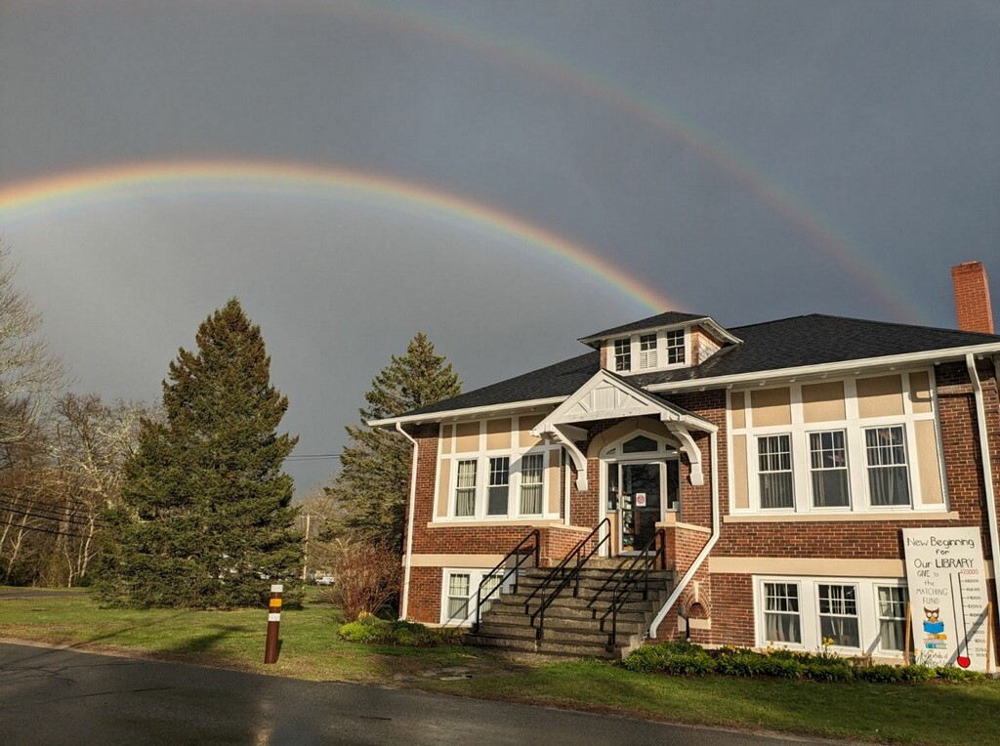
Berkley Public Library

Slide 2
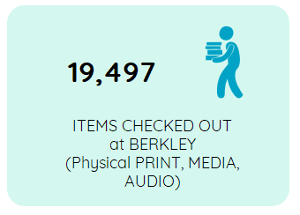
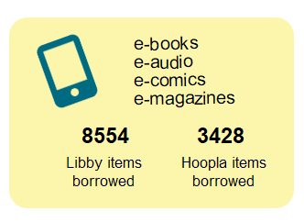

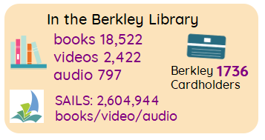

2025

Slide 3
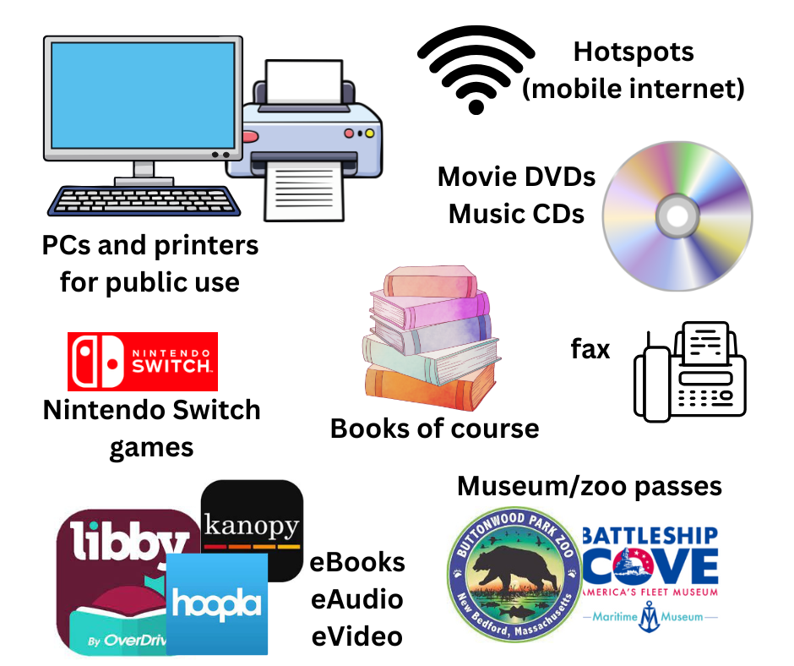

What we have at the library

Slide 4
Library Staff
Director: management and administrative tasks, adult programming
Children’s Librarian: runs the Children’s room and teen space
Technical Services Librarian: catalogs and repairs books & other items
Circulation Librarian: in charge of circulation of books & other items
Custodian
The library is open 30 hours a week. To have one librarian per floor we need 60 employee hours.

Slide 5
Library Budget
The library budget is < 1% of the total town budget
The library budget is the lowest in the SAILS network
Our salaries are the lowest in the SAILS network
With a 6% reduction in our budget, we will need to use up our reserves (state aid savings). That will lead to decertification in future years.
If decertified:
No state aid
We can’t participate in the SAILS network
We won’t be able to participate in grant programs

Slide 6
Other Sources of Funding
Funding Source | FY25 | FY26
Friends | $4990 | $2000
Cultural Council grants | $1320 | $400
Dollar General grant |  | $1200
BayCoast donation | $250
State Aid | $14500 | $20000
Donations | $3365 | $14000*
* In FY26, we received a $10,000 donation from the Carnegie Corporation that we will use to offset a capital request.

